Slide 1



Minor Project
Submitting by -:
Nishant Kumar

Slide 2


Introduction
What is mid-day meal scheme ?
The Midday Meal Scheme comes under the HRD Ministry’s Department of School Education and Literacy.
Launched in the year 1995 as a centrally sponsored scheme.
Objectives :
It provides that every child within the age group of six to fourteen years studying in classes I to VIII who enrolls and attends the school shall be provided hot cooked meals.
It is having nutritional standards of 450 calories and 12 gm of protein for primary (IV class) and 700 calories and 20 gm protein for upper primary (VI-VIII class), free of charge every day except on school holidays.

Slide 3
Problem Statement
Ensuring number of students that took meal is same number reported.
Here is some news articles showing why this problem arised?
Is there any part of the country or is there any segment of the running of the system without corruption? We all know, the answer is big NO.
Here’s a report conducted in 2015. CAG's performance audit report of Mid Day meal not only found found financial mismanagement by the HRD ministry but it has also discovered states having indulged in in diversion of funds to the tune of ₹123.29 crore meant for the scheme.

Slide 4
Now let's talk about Solution

Slide 5
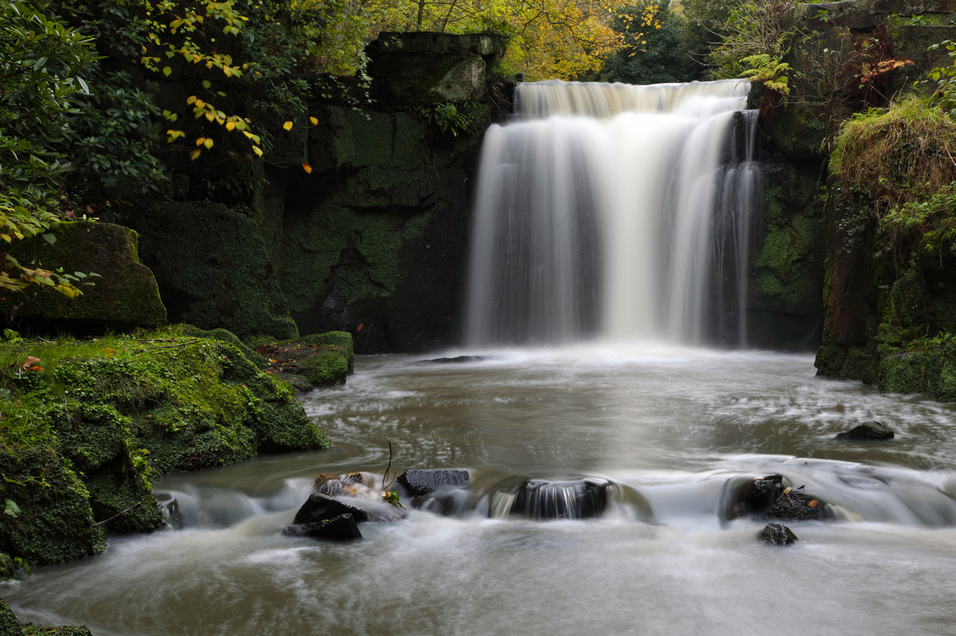
For implementing the solution we've used -:
Classical Waterfall Model

Slide 6
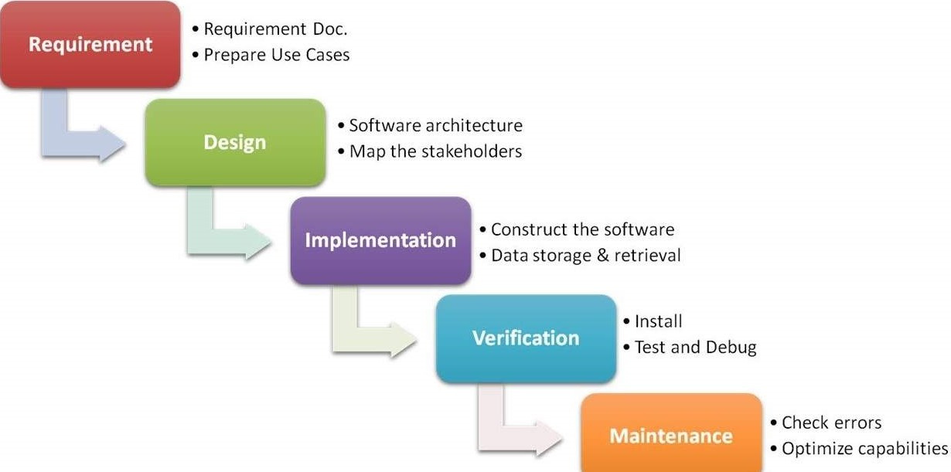

Slide 7

Requirements
Installed jupyter notebook
Installed openCV
Installed Tkinter
Working webcam

Slide 8
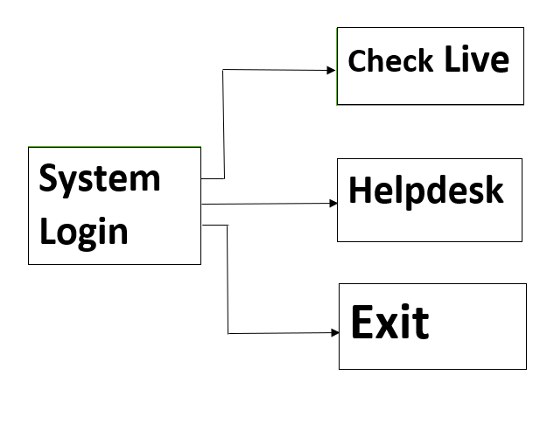
Design
For designing phase we made the GUI of software using the in-built python module tkinter

Slide 9
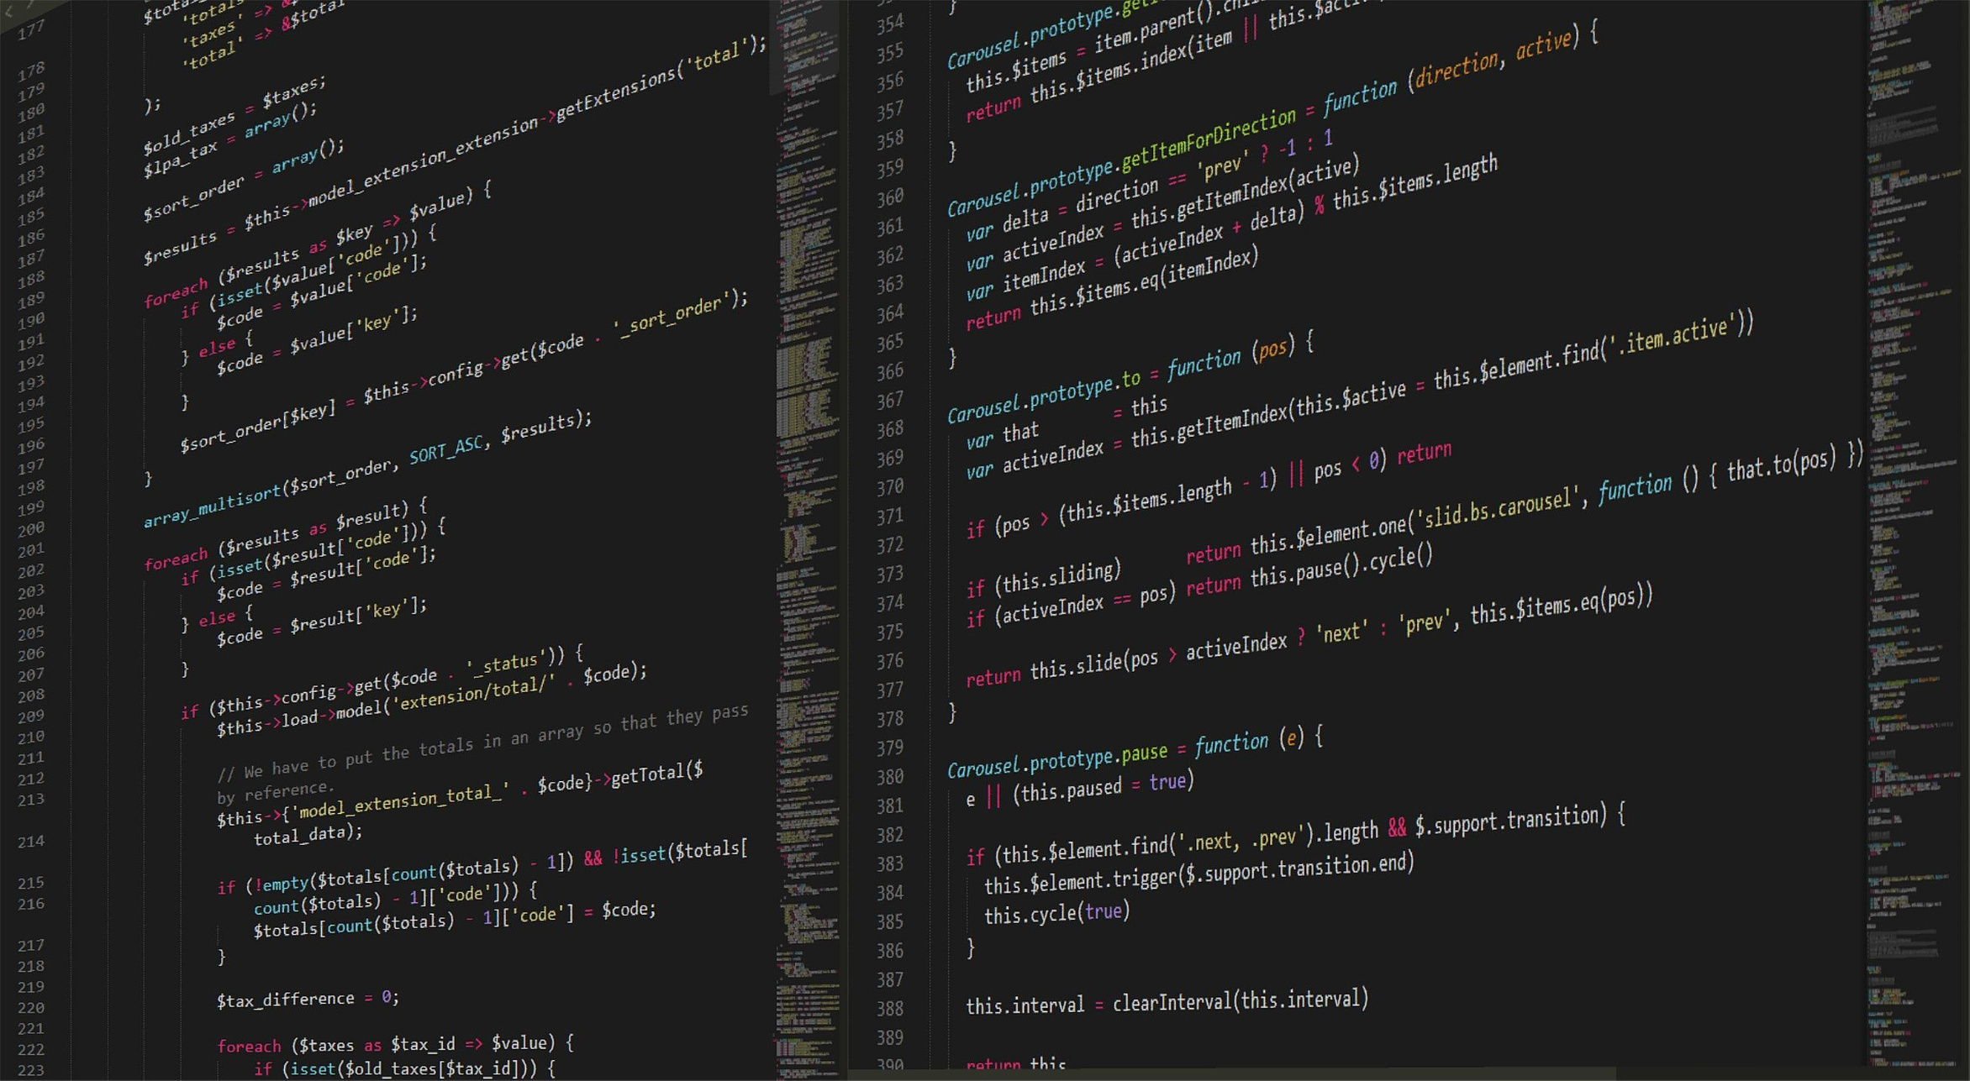
Now the Implementation
Phase of Software

Slide 10
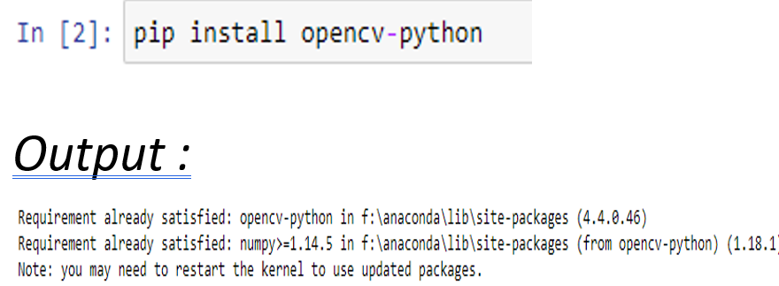
Command of Installing
OpenCV

Slide 11
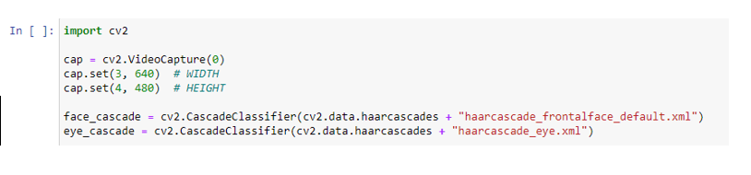
Code :
Here we're using two function of cv2 class in openCV -:
Videocapture()
CascadeClassifier()

Slide 12
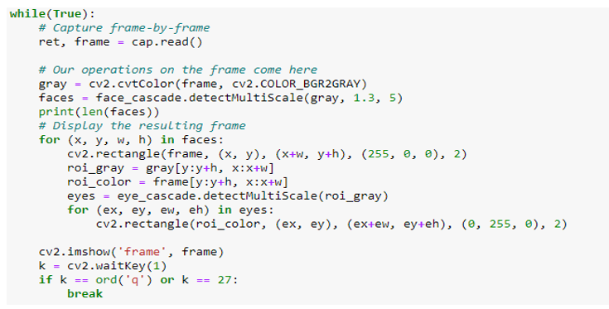
Now we're using the while loop to perform the following actions -:
To capture video frame-by-frame.
Two operations will be done on frame :
converting the frame into gray scale image.
using detectMultiScale to detect multiple faces.

Slide 13
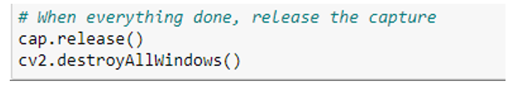
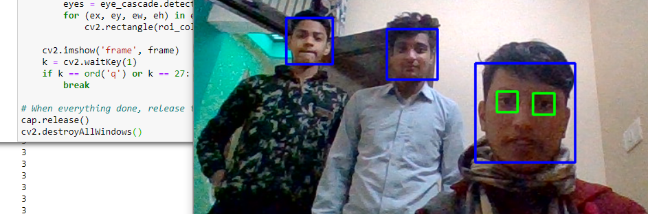
Now final step is the releasing the capture when everything is done
Output -:

Slide 14
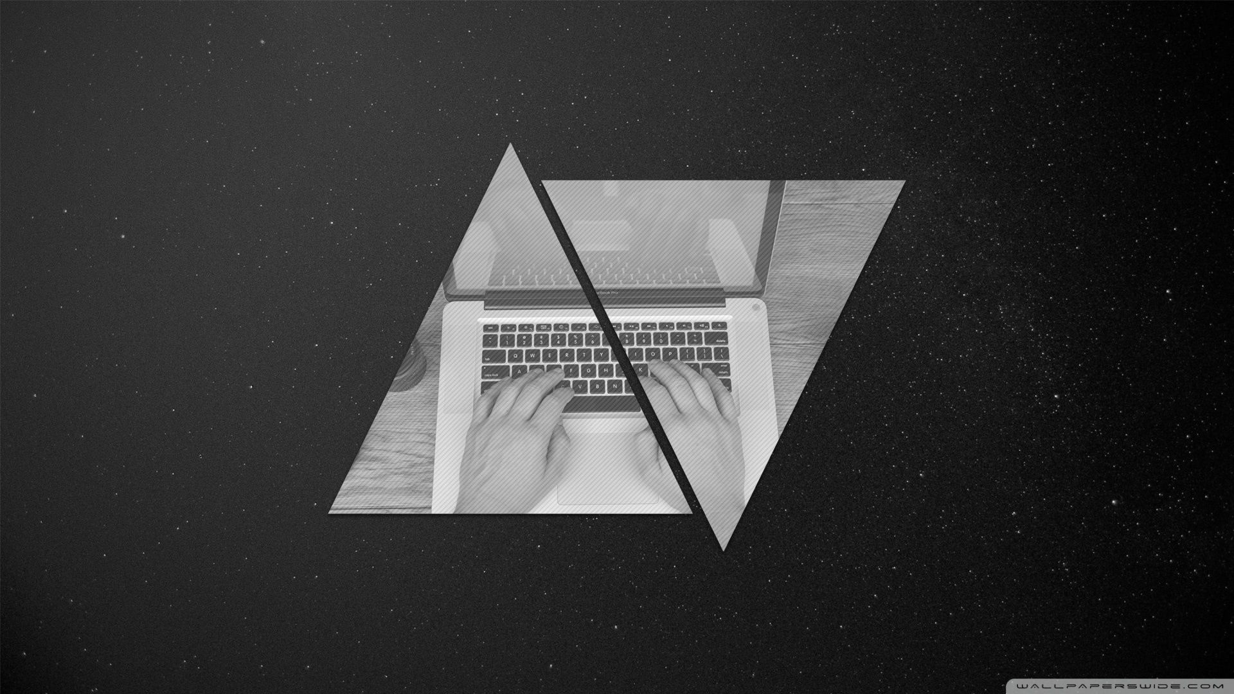
Now let's see the verification of our model

Slide 15
Maintainance
Maintenance is the most important phase of a software life cycle. The effort spend on maintenance is the 60% of the total effort spend to develop a full software. The software is designed by using Tkinter. The main part of maintenance is make the software user-friendly. And we have tried our best to make it user friendly. Keeping in mind the security purposes, we have given the options for system login. So that only limited number of person who know's the username and password will be able to open and check the live status. Because of which government can keep their mid day meal data safe & secure. we've also provide an option of helpdesk which help the person to contact us in case of any failure and in future we also keep updating our software so that people can more easily intract with our software.

Slide 16
Conclusion
In the face count using Webcam project, every student's face is detected and count the total number of students present during food distribution. So, there will be no rigging. And this system will help government to avoid broker who send 100 students bill in place of 50 students to the government. Hence, government can use the money left from the broker to give better quality and nutritious food to the students. That will help to the students to grow physically and mentally both.

Slide 17

Future Aspects :
In future , we can add a feature of detection of food also.
Detect unhygienic surrounding.
A multi functioning software includes:
Management of the mid-day meal
Monitoring of attendance (Automated Monitoring System)

